Slide 1
Public Procurements in a circular economy
International Conference, Public Procurement Authority
Budapest, 14 Nov. 2017

Slide 2
Content
What is a circular economy?
1
Definition
International and EU context
What is a circular procurement?
2
Definition
Recommended reading, references
Approaches to circular procurement
Links between circular economy and procurement
Practical case studies

Slide 3
What is a circular economy?
Concept: “A circular economy is restorative and regenerative by design, and aims to keep products, components, and materials at their highest utility and value at all times.”*
Principles: preserve natural capital, circulate products/materials at highest utility, system thinking, functional service economy
Expected benefits: estimated 170 000 jobs in the EU, reducing GHG emission by 2-4%, GDP growth (up to 7% in the EU)
*Source: Ellen MacArthur Foundation – concept of the Circular Economy

Slide 4
Consumption and use
Re-use / Repair / Recycling
Manufacturing / Design
Circular Economy
Resources
Waste
Linear Economy
Resources
Waste
TAKE
MAKE
DISPOSE

Slide 5
EU Circular Economy Package (2015) - EU Action Plan for Circular Economy - List of follow-up initiatives - Legislative proposals on waste
Action areas
Production
Objectives: Circular Product Design, Innovative production processes
Key actions: Eco-design Directive, Extended Producer Liability
Consumption
Objectives: Product re-use, repair, support new form of consumptions, provide reliable information to customers
Key actions: Procurement Directives (circular criteria in GPP), encouraging GPP, Labelling
Waste Management
Objectives: improve waste management practices, optimize implementation (recycling 65% of municipal waste and 75% of packaging waste, reduce landfill to maximum of 10% by 2030)
Key actions : revised targets for recycling, reduce landfill, coherence of waste hierarchy and investments
Secondary Raw Materials
Objectives: increase the use of secondary raw materials and recycled nutrients, safe management of chemicals
Key actions: regulation of fertilizers, minimum requirements for re-used water, cross-border transfer of waste

Slide 6
Circular Procurement (1)
Different approaches, not yet agreed definition
In the Circular Economy „the value of products, materials and resources is maintained in the economy for as long as possible and the generation of waste is minimized.“ (European Commission, 2015)
Circular Procurement aims to minimize waste,, focuses on reuse, repair and recycle practices, effects the whole supply chain.
Integration of GPP/SPP into the system of Circular Economy
Circular Procurement – Green Procurement – Sustainable Procurement

Slide 7
Four Approaches to Circular Procurement*
Procurement includes “circular” criteria
Improved products, services with GPP and circular criteria
Procuring new circular products
During PPI developed products (with longer life-cycle)
Procurement of services instead of products (product-service systems)
Supporting new business models e.g. leasing, pay per use, selling back, shared used
Procure to promote circular ecosystems
Waste as a research
Promoting closed loops
*Salmenperä, Hanna, et al. (2017), „Four approaches to circular procurement“, in Circular Public Procurement in the Nordic Countries, Nordic Council of Ministers, Copenhagen K.

Slide 8
Possible Business Modells in a Circular Economy
Developing business models* that fit to a circular economy:
Circular supplies (e.g. using renewable energy, biodegradable materials etc.)
Resource recovery (e.g converting waste into energy e.g. biogas, C2C concept)
Product life extension (by circular design, repair, maintenance, softver upgrade, re-sale etc.)
Sharing platform (shared use/access/ownership of products, services)
Product as a service (leasing, pay for use, subscription based rental)
Source: Accenture, Circular Advantage, 2014

Slide 9
Circular Procurement (3)
Before
Development of organisational CE policy, extending the procurement policy
Development of category management
Assessment and application of the relevant business model
Considering the 4R (Reduce, Reuse, Recycle, Recover)
Dialogue along the whole supple chain (between buyers and suppliers)
Engaging the market, market consultations
During
Applying performance-based specification
Considering requirement related to recycled content
Including the EU GPP criteria
Considering appropriate labels
Developing specific LCC/TCO calculation methods
After
Considering the end of contract life (PSS, Buy-back or re-sale agreement)
Summarizing lessons learned, considering future business cases
Supporting continuous improvement

Slide 10
Circular Procurement – Updated Resources, reports
Green Public Procurement and the Action Plan for the Circular Economy, European Parliament, June 2017
Report from the EC on the implementation of the Circular Economy Action Plan, European Commission, January 2017
Circular Public Procurement in the Nordic Countries, Nordic Council of Ministers, 2017
Using Product Service Systems to Enhance Sustainable Public Procurement, UNEP, May 2015
Public Procurement for a Circular Economy, European Commission, Oktober 2017
REBus project reports, EU Life+ Project 2015 and Best Practice Report – Circular Procurement, SPP Region Horizon2020 Project, 2017
Moving towards a circular economy with EMAS, European Commission, Oktober 2017

Slide 11
Circular Procurement Case Studies
C2C City hall Venlo, the Netherlands, design and build contract, project 2007 – 2016
Procurement of recycled bricks Odense Municipality, Denmark, building contract, 2011
Procurement of car sharing services Herford and Bremen, Germany, service contracts, 2017 and 2013
Procurement of biogas buses, Vaasa, Finland, 2014-2017
Leasing recyclable workwear, Rijswaterstaat, the Netherlands, REBus EU Project further case studies
Procurement of hybrid hospital mattresses, Cambridge University Hospital Foundation Trust, UK, SPP Region EU Project case studies

Slide 12
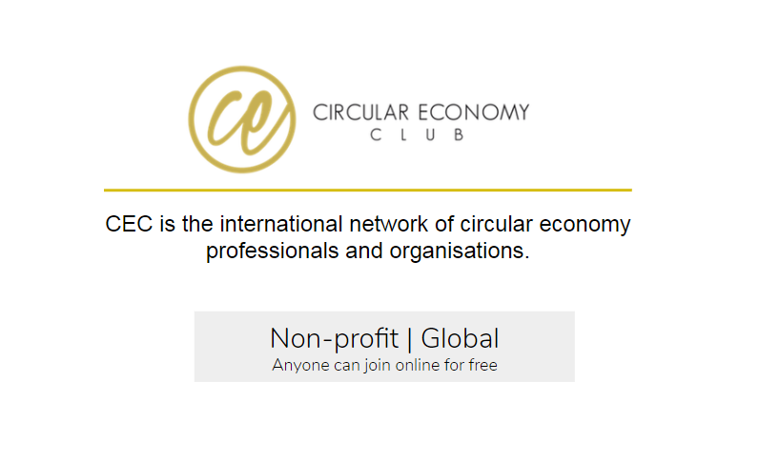
Solving challenges: sharing knowledge & connections
Events, conferences, CE Mapping Week February 2018
CEC Mentor programme
CEC Local Organisers
Challenges need to be identified locally, by experts on the field
Gathering stakeholders, that have direct contact with the ‘problems’, is crucial
Leading voices need online visibility and international support (CEC Platform website, twitter)
For more information visit: www.CircularEconomyClub.com

Slide 13
What do you see?
Source : www.waitbutwhy.com „Circles“

Slide 14
Thank you for your attention!
Contacts: dr. Gabriella Gyori
Email: gabriella.gyori@gmail.com
CEC Profile
Twitter

